Slide 1

What Signals an Economic Downturn?
By: Benjamin Aubry, Gary Fisher, and Bruce Mark

Slide 2
Every day, trillions of dollars are traded around the world by both humans and computers. The common goal between all parties involved is to make a profit on their respective trading strategies. When is the next market downturn?
Our Primary Question: What are potential economic and financial measurements that can be used to predetermine a downturn or recession in the US financial markets?
- Our team’s goal for this project is to each analyze a different securities’ data set in order to compare them to the S&P 500, then draw conclusions on whether the information reveals potential sell signals.

Slide 3
Can comparing yields between equities (stocks) and bonds predict a market downturn?
Why analyze these metrics? Equities (stocks) and bonds generally move in opposite directions from one another. By converting the equity prices to its yield equivalent, we can then directly compare equity yields to bond yields in order to find a trend.
Relevant Data Highlights:
Source: Quandl.com
Pricing Used: CME-S&P 500 spot month futures, US 10-Year Treasury Rate, and US 2-Year Treasury Rate

Slide 4
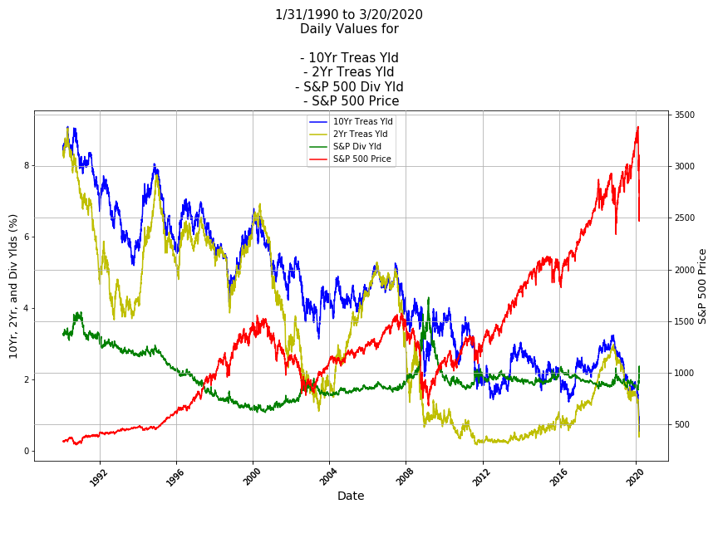

Slide 5
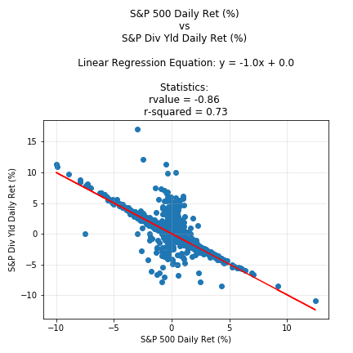
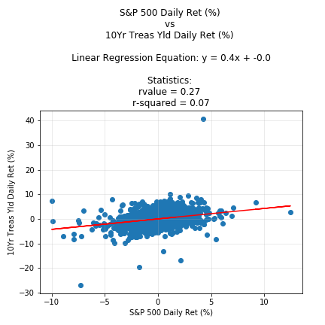
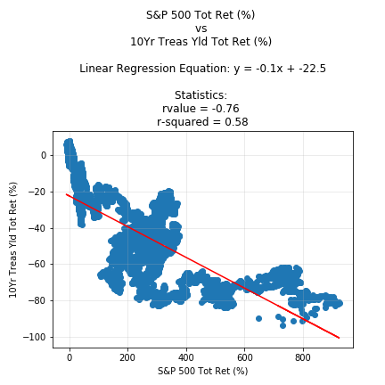
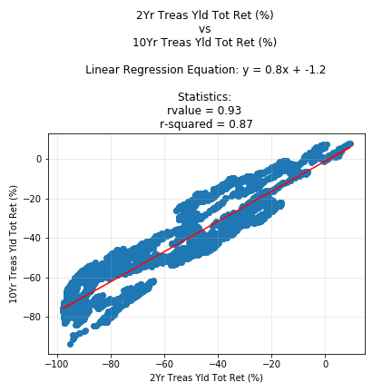

Slide 6
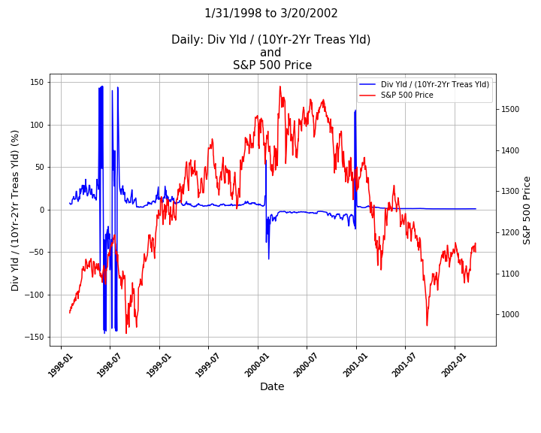
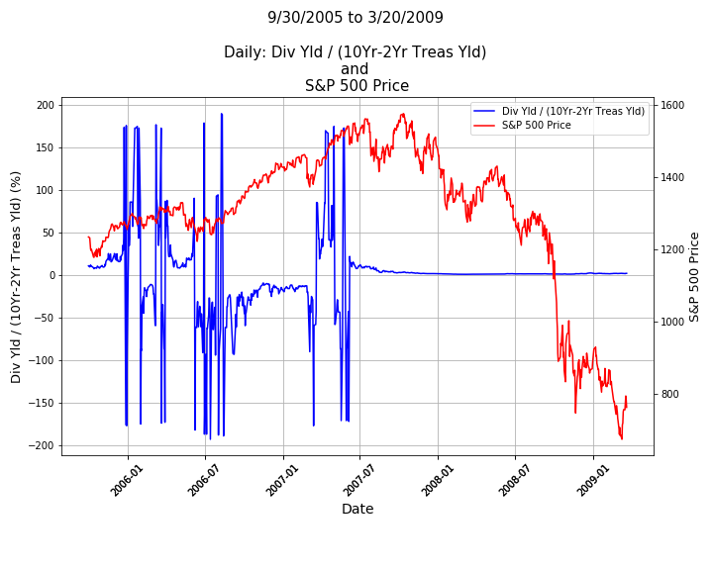

Slide 7
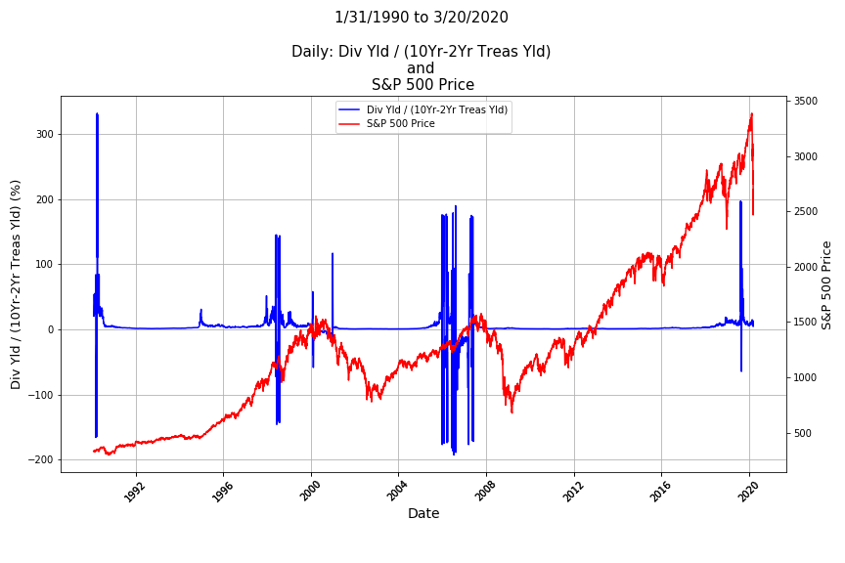

Slide 8
Conclusion:
The ratio previously compared to the S&P 500 does appear to be a leading indicator for trying to anticipate a large market downturn.
The most important part of the indicator seems to be when the ratio is above or below zero (0).
Only after the ratio changes from negative to positive will the “sell” signal be triggered.
Additional analysis will need to be performed on data before 1990 in order to compare results.

Slide 9
Questions?

